Slide 1
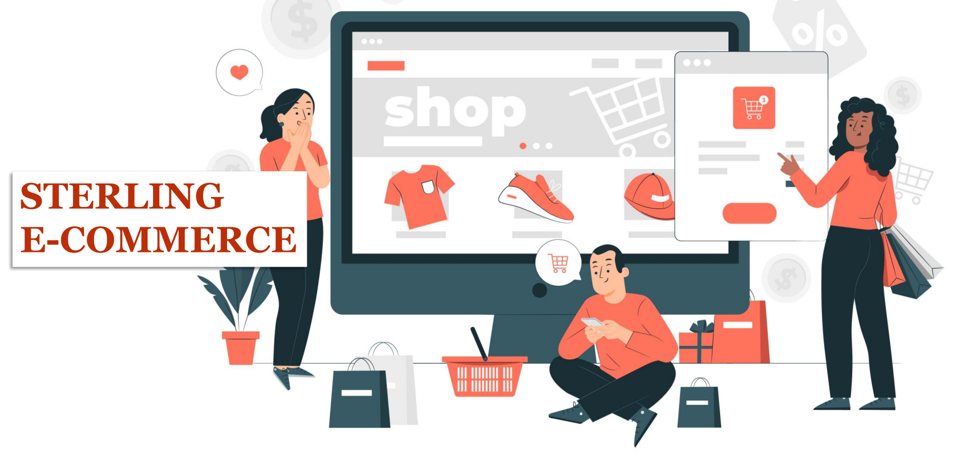

Sterling E-Commerce Customer Experience Report
(A data-driven strategy to optimize Business growth)
Prepared by the Data Science Team members
Ibrahim Lasisi
Vincent Ajaegbu
Tabi Franckline Tambe
Olalekan Adebayo
Aghware Mary Oghenevovwero
Date: 24 May 2024.

Slide 2

Table of Contents
Introduction
Data understanding
Sales Performance Overview
Customer Analysis
Product Performance Analysis
Trend Analysis
Recommendations and Conclusion
Question and Discussion

Slide 3

Introduction
Sterling E-Commerce, a fast-growing company stands at the forefront of modern marketing, poised to harness the power of data for unprecedented growth and enhance efficiency and customer experience. Sterling E-commerce has entrusted our team of experienced data scientists, with the responsibility of optimizing product offerings, streamlining operations, and enhancing the customer experience and preferences.
In our discoveries, we unravel the hidden patterns and trends that solve not only the company’s problem of optimizing product offerings among customer categories, streamlining operations, and elevating the customer experience to new heights but, are equally capable of positioning the company as the industry leaderboard with a landmark competitive edge post-implementation.

Slide 4

Data Understanding
The data provided is a sales report of between 2021 and 2022 showing the company sales trend withing various product line by customer category from different country, unique states and region. Below is the data explanation.
Category – The category of goods
City – The city where customers are ordering from
County – The county where customers are ordering from
Cust Id – Customer ID
Customer Since – The date when the customer first order.
Date of Order – The date when the customer placed an order
Full Name – Customer’s full name
Gender – (Male, Female)
Item Id – Item ID

Slide 5
Data Understanding (cont.…)
Order Id – Order ID.
Payment Method – The payment platform the customer used
Place Name – The exact location where the customer is ordering from.
Ref Num – Reference Number
Region – The region where the customer is ordering from.
State - The state where the customer is ordering from
User Name – The customer’s username
Zip – Customer’s zip code
Qty Ordered – The quantity of goods ordered
Total – Total amount paid by customer.

Slide 6
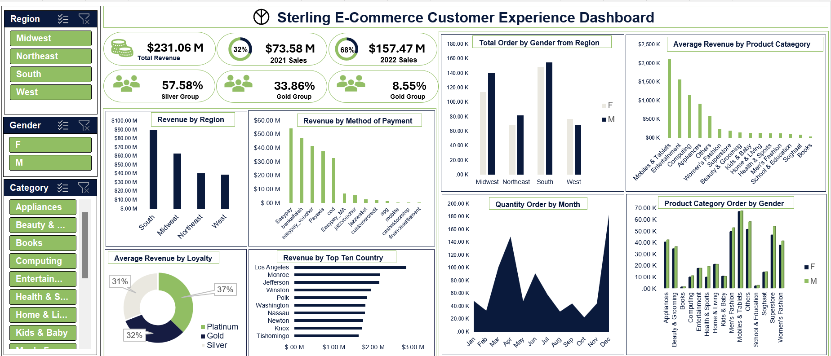

Slide 7
Sales Overview
Quantity Order by Month
Sterling E-Commerce experienced a significant increase in sales from 2021 and 2022 with 113.88%, a value which indicates positive performance growth and market grip with a total of $73.58m and $157.47m in 2021 and 2022, respectively.
Review shows that buck of this revenue was generated from the Mobile and Tablets product category which generated an average revenue of $2,110k followed by Entertainment with average revenue of $1,563k.
From our insights, we established that an integral part of the company’s revenue was generated from the South region with $89.64m followed by the Midwest with $62.92m while the Northeast and West have a close range of $39.96m and $38.53m respectively.
A consolidated review revealed the top 10 countries from which the highest revenue was generated ranging from Los Angeles, Monroe, Jefferson, Winston, Polk, Washington, Nassau, Newton, Knox, and Tishomingo.
With our diligent review of sales trends by month of order, we discovered seasonality in the purchase pattern with a hike in the month of April and December.
Average Revenue by Product Category

Slide 8
Customer Analysis
Sterling E-Commerce base stands at 283,078, 51% of which are Male and 49% Female
A review of gender interaction regarding product orders shows that the Male gender made more orders than the Female in the regions except in the West which sees more orders from the Female gender.
We established in our review how the gender has responded to each product line showing the purchasing trend.
Engaging our data analytical prowess and technical skills with a deliberate intention to capture and categorize Sterling customers into the appropriate bracket to monitor lifestyle, social class, and purchasing ability and enhance product offerings, we grouped the customers into three categories. (Silver, Gold, and Platinum)
We discovered that despite being the least in count, the Platinum group has contributed more to the company's average revenue with contributions standing at 37% for Platinum, 32% for Gold, and 31% for Silver.
Dispersion of count of customers over the region shows the highest number of Sterling customers are from the South at 37%, Midwest at 29%, Northeast at 18%, and West at 17%. This explains the revenue generation from the regions.
The Silver (0 – 14years), The Gold(15 – 29years) and The Platinum(30 – 44years)

Slide 9
Product performance Analysis
Product Category Order by Gender
Reviewing product performance is a key metric in understanding customer preferences and optimizing sales strategies. We delved into the product analysis with a diligent review to discover the trend, identify the top-performing products, and establish each product’s contribution to the company’s revenue and overall growth. We established the following facts.
Among the product categories, the Mobile and Tablets have the highest number of orders and contributed more to the Sterling total revenue than every other product.
As also revealed in our findings, both the Male and Female genders made a high number of orders for Mobile and Tablets products.
The top 5 performing products are Mobile and Tablets, Entertainment, Computing, Appliances and Others.
The least 5 performing products are Health & Sport, Men’s Fashion, School & Education, Soghaat, and Books coming last.

Slide 10
Trend Analysis
Product Monthly Order Trend
With a thorough review of Sterling sales data, we discovered the seasonal and emerging market trends and anticipated future demand shifts. We established the following trends. An in-depth review of how each product faired in each month shows the product leader board for each month as follows.
Sterling only recorded transactions for the last quarter of 2021 and the first 3 quarters of 2022 based on the data provided.
Mobiles & Tablets has the highest in October 2021 with 2074 orders.
Mobiles & Tablets also in November 2021 with a total order of 3897.
Mobiles & Tablets in December 2021 with 18,860 orders.
Men’s Fashion top in January 2022 with a total order of 3214.
February 2022, Mobiles & Tablets with 1852.
Mobiles & Tablets in March 2022 with 5518.
Other product categories led the quantity order chart in April 2022 with total order of 17,215.
As though the other three products did quite well in May 2022, Mobiles & Tablets top with 2323 orders.
Mobiles & Tablets top quantity order all in June, July, August, and September with 7076, 3702, 3507, and 2609 respectively.

Slide 11
Recommendation
Given a clear indication of customers spending more on Mobiles and Tablets, launching a new Mobile and Tablet product or enhancing an existing one is crucial to sustaining the company’s market dominance.
With a substantial portion of revenue realized from the South and Midwest regions, directing resources to these areas for targeted and strategic marketing, distribution, and exceptional customer service engagement is imperative.
A re-evaluation of market strategies for the least performing product categories is necessary to optimize future performance.
A promotional offering as an incentive for the most performing customer group and encourage the least performing customer group.

Slide 12

Questions and Discussion

